Slide 1
TensorFlow
ST CLAIR COLLEGE
Presentation On
Presented By: Ajima Master

Slide 2

What is TensorFlow
TensorFlow=Tensor+ Flow=Flow of Data

Slide 3
What is TensorFlow
TensorFlow is an open-source software library for machine learning and artificial Intelligence.
It can be used for a range of tasks, but it is now used for training ML models.
Google's most advance image advanced image recognition system.
TensorFlow 2.0 Today
Easier to use
Code style for beginners and experts
Run on multiple CPU and mobile operating system
Alpha release in March 2019

Slide 4
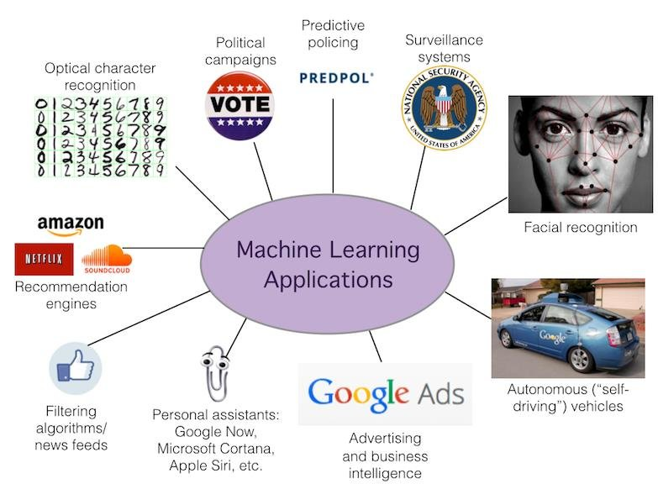
What is Machine Learning
Machine learning is the study of computer algorithms that can improve automatically through experience and by the use of data.

Slide 5
What is Deep Learning
Deep learning is a subset of machine learning, Which is essentially a neural network with representational learning.
It processes multiple layers to extract high feature of data.
Deep-learning architectures such as deep neural networks, deep belief networks, deep reinforcement learning, recurrent neural networks, and convolutional neural
networks have been applied to fields including computer vision, speech recognition, natural language processing, machine translation, bioinformatics, drug design, medical image analysis, climate science,

Slide 6
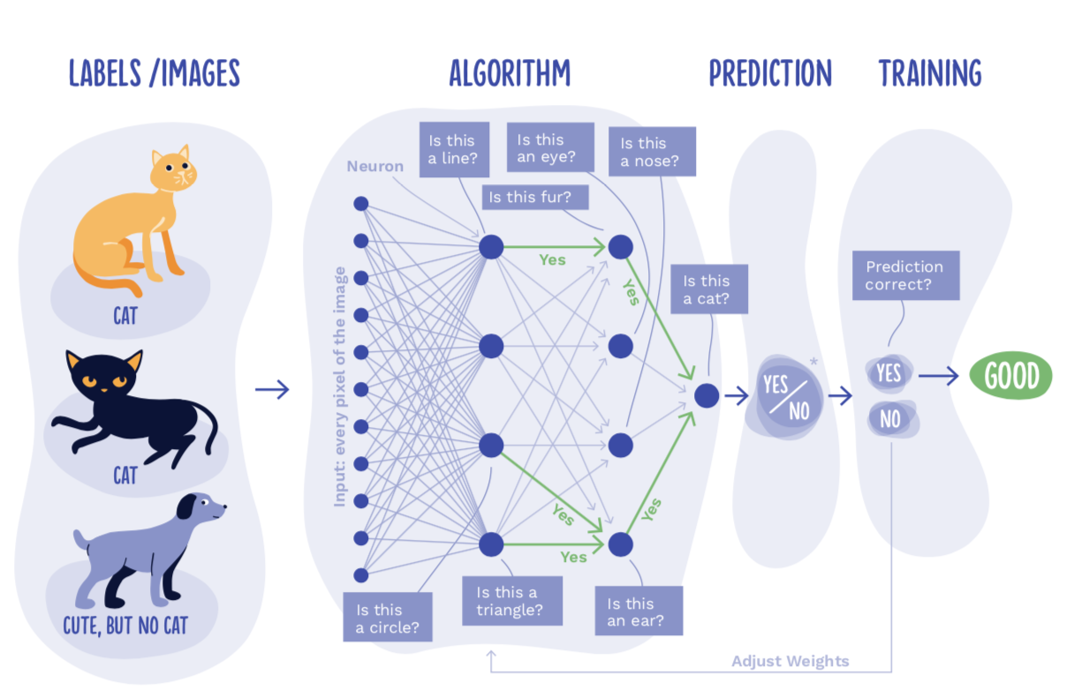
What is the neural network

Slide 7
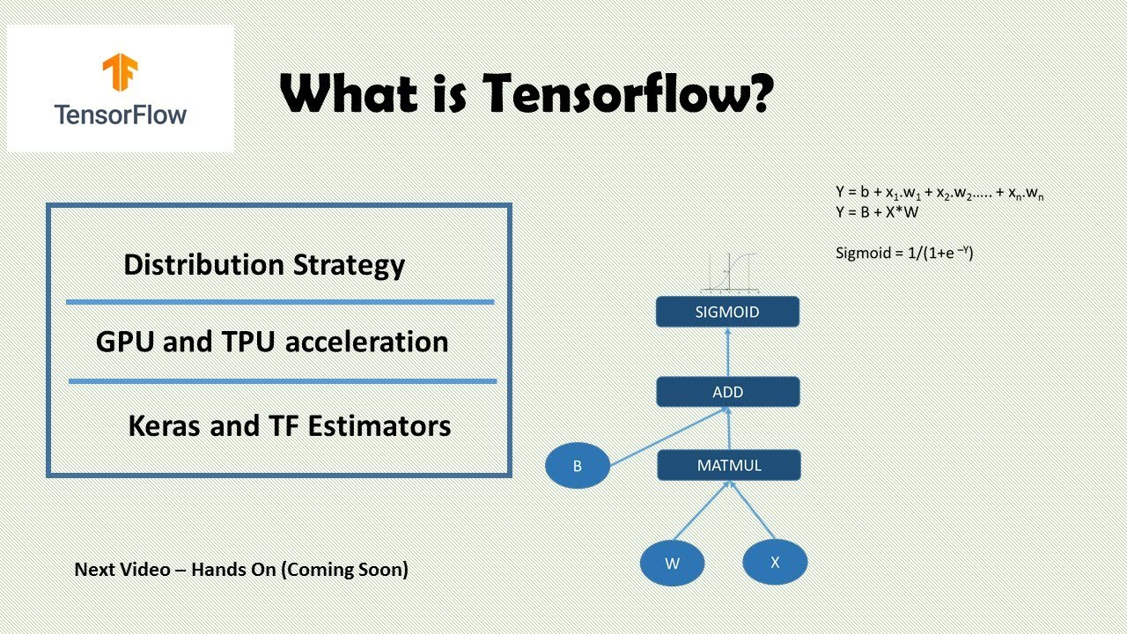

Slide 8
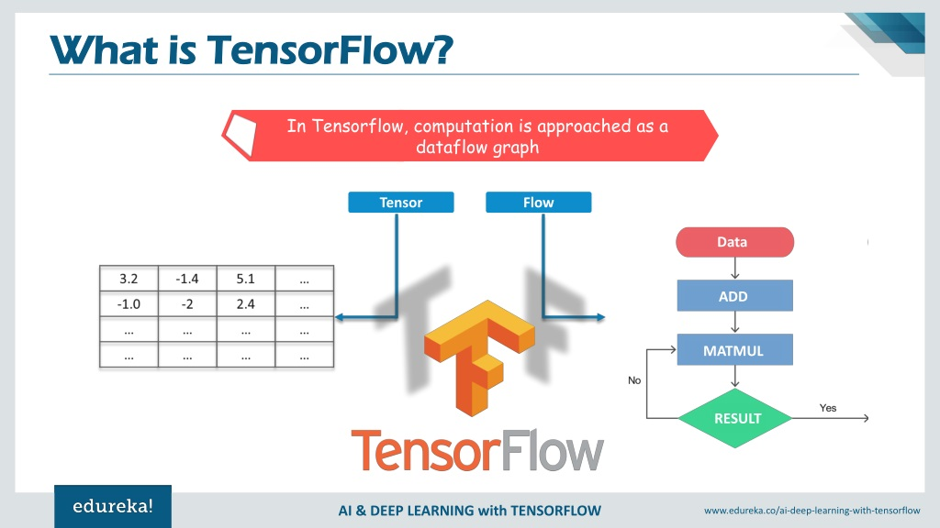
TensorFlow
An n-dimensional Array
0-d tensor: scalar
1-d tensor:vector

Slide 9
Why TensorFlow
Run on Desktop and mobile device
Ios
Raspberry pi
Linux
Windows

Slide 10
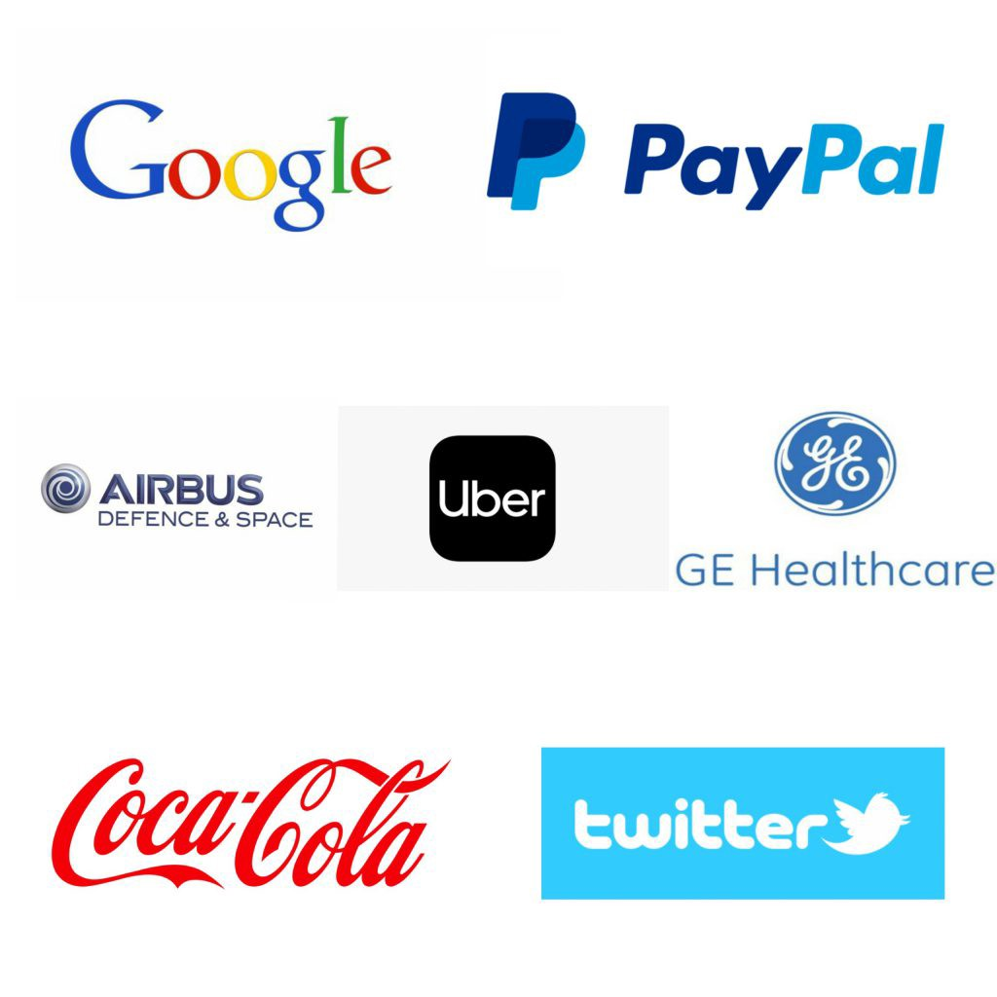
Use case of TensorFlow

Slide 11
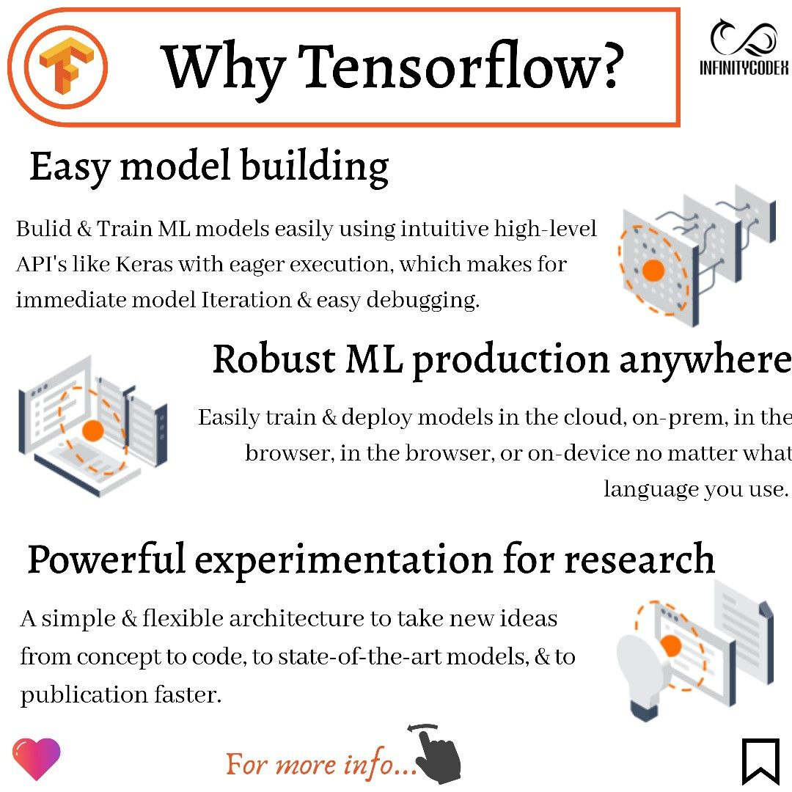

Slide 12
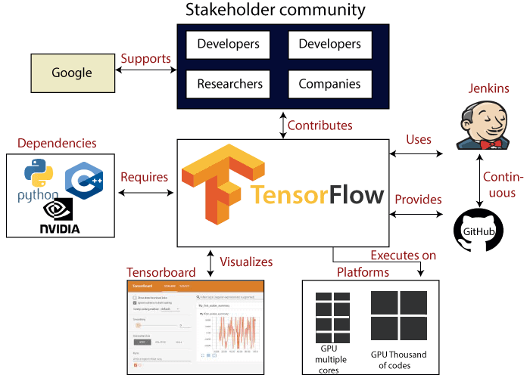
TensorFlow Use Case

Slide 13
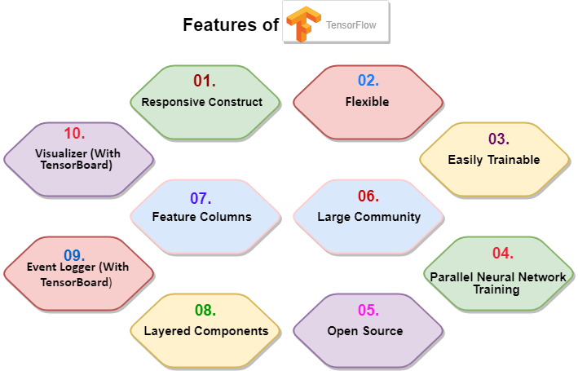
Feature of tensorFlow

Slide 14
Programming Model
Big idea: Express a numeric computation as a graph.
Graph nodes are operations which have any number of inputs and outputs
Graph edges are tensors which flow between nodes

Slide 15
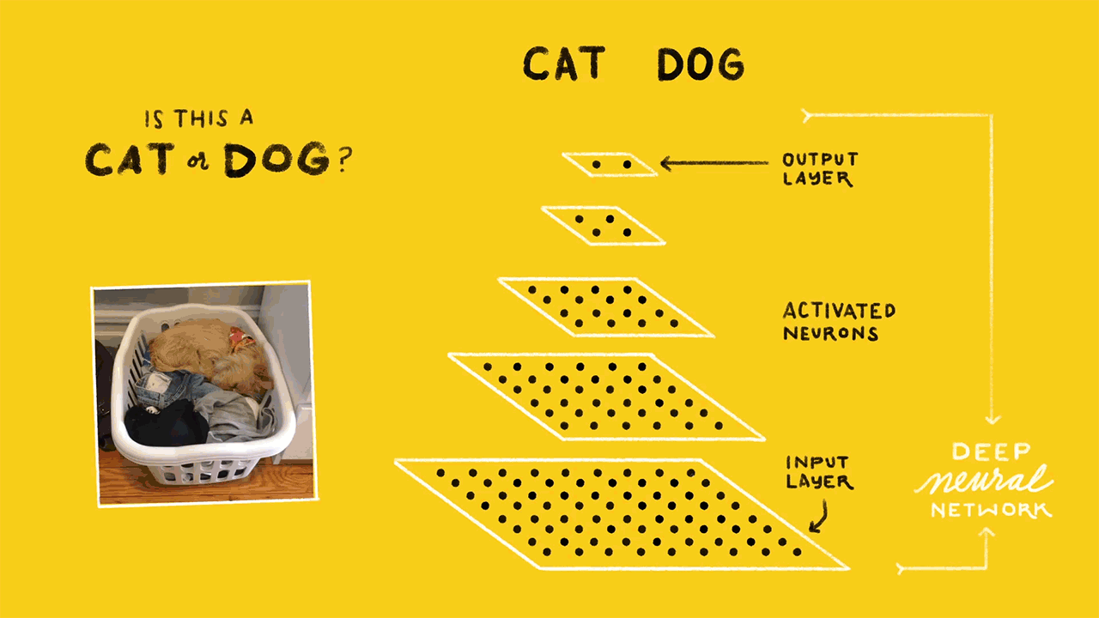
Cool project with TensorFlow

